Slide 1

Analysis of Photocatalytic Degradation Using Artificial Neural Network
Anshika(2017BCHE016)
Arpit Shukla(2017BCHE062)
Sandeep Singh Tomar(2017BCHE029)
Under supervision Of :
Dr. Tanveer Rasool
Assistant Professor
Department OF Chemical Engineering

Slide 2
Index
Topic
Introduction
Objectives
Literature Review
Materials and Methods
Conclusion
Future Recommendations
References
Page no.
3
5
6
9
15
17
18

Slide 3
Introduction
Water is the most precious resource of human civilization.
With the intensification of industrial and agricultural activities, the continuous discharge of toxic organic pollutants into water bodies pollute water resources.
Water-soluble organic pollutants, especially phenolic compounds, have an annual global production of about 3 million tons, which is an emerging pollutant (ECs).
Heavy exposure to phenol can be fatal to humans. It can quickly penetrate the skin and cause severe painless burns.
Traditional methods to remove phenolic compounds :
Biological treatment
Adsorption in the activated carbon
But they are slow processes and transport pollutants from one environment to another.

Slide 4
So advanced oxidation processes (AOP) is used to oxidize hazardous and difficult-to-handle organic compounds.
AOP is based on the formation of hydroxyl radicals.
Various methods of generating hydroxyl radicals include :
Ozone using ultraviolet rays
Hydrogen peroxide using ultraviolet rays
Photocatalysis using semiconductors
Processes like ozonation, are more expensive than using UV catalysts.
Titanium dioxide is selected as a photocatalyst because it is non-toxic, highly active, photochemically inert and low in price.

Slide 5
Objectives
The main objective of the project is the degradation of phenol by TiO2 nanoparticles. The ANN is also used for training the model and predicting the results with Input Parameters pH, phenol concentration, catalyst doses and degradation time.
Study of toxicity of phenolic compounds
Use of Artificial Neural Network to ease the computation
Study of TiO2 nanoparticle
To predict and validate the data points obtained from research papers.

Slide 6
Literature Review
This chapter reviews previous work and studies on the photocatalytic degradation of phenol by TiO2 nanoparticles. The aim was to provide information that would provide the context within which the project on degradation of phenol by TiO2 could be Undertaken more comprehensively.
This work provides an insight into statistical modelling and optimization which could provide exposure for developing an optimized nanomaterial towards the removal of hazardous pollutants.

Slide 7
Zulfiqar et al. (2019)
The target element was phenol while Tio2 was used as a photocatalytic material. The artificial neural network (ANN) was employed for suitable modelling and optimized condition of the TiO2 nanoparticles in yielding a profound rate of phenol removal. The designed system fits well with the Pseudo-First-Order and the Langmuir isotherm model with R2 > 0.999.
Tanzifi et al. (2018)
This work focus on the performance of SiO2 nanocomposite for removing Amido Black 10B dye from aqueous solution. The effect of different variables, such as adsorption time, the mass of adsorbent, solution pH and initial dye concentration was studied and also was optimized by an Artificial Neural Network (ANN) method.

Slide 8
Tanzifi et al. (2018)
In this study, TiO2 nanocomposite was synthesized by a polymerization method, and was used for adsorption of Congo Red from aqueous solution. The effects of operational parameters of the adsorption process including pH, initial dye concentration, temperature, adsorbent dosage, and adsorption time on adsorption efficiency were investigated.
Ali et al. (2018)
The sorption of amido black dye in water on iron composite nano material , starting amido black amount, agitation time, pH, nano martial dose, and temp. The artificial neural network modelling confirmed the applicability of the developed method. The method was competent to grind at normal water assets pHs with low sorbent amount and agitate time.

Slide 9
Materials and Methods
Titanium dioxide (TiO2) nanoparticles (purity ≥ 99.5%) with specific surface area of 49.16 m2/g and 21 nm particle size.
NaOH (purity = 95%)
HNO3 (purity = 95%)
HCl (purity = 95%)
Phenol (purity > 99%)
Titanium dioxide can be used without pretreatment and provides the best catalytic efficiency.
The solution of phenol and TiO2 in distilled water was prepared and the pH of the solution was adjusted with nitric acid (HNO3).

Slide 10
Artificial Neural Network
ANN is a computing method useful to imitating the learning skills of biological cells and human brain. It is collection of connected nodes which is called artificial nodes.
Neuron is the basic building block of Artificial Neural Network.
Each connection, like the synapses in a biological brain, can transmit a signal to other neurons. An artificial neuron that receives a signal then processes it and can signal neurons connected to it.

Slide 11
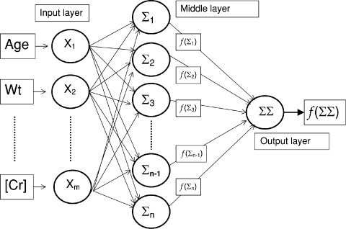
ANN Architecture

Slide 12
How it is used in Modelling
The feed-forward neural network with back propagation method has been used for the model development.
Levenberg-Marquardt (LM) was used for the training of the network.
The input layer comprises of four (04) number of neurons such as; pH, time (min), dose (g/L) and concentration (mg/L), while the output layer comprises one (01) neuron i.e. phenol degradation (%).
The number of neurons in the hidden layer was selected by a iterative approach to produce the minimum RMSE for the training network.

Slide 13
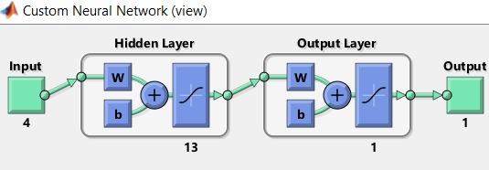
Custom view of Neural Network in MATLAB

Slide 14
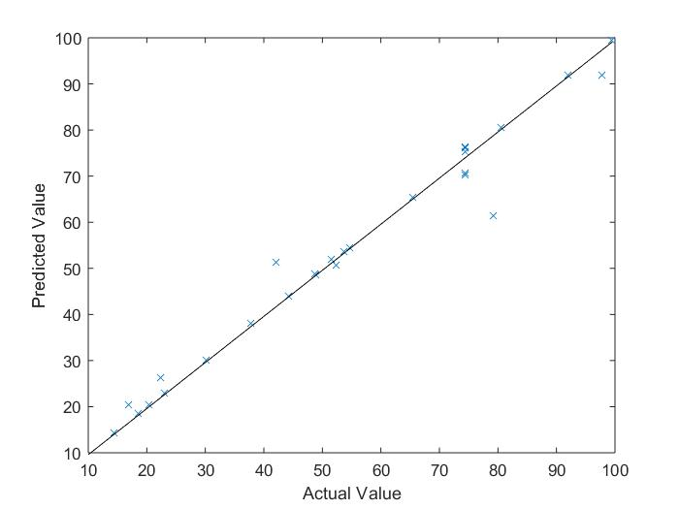
Comparison of Results obtained from ANN

Slide 15
Conclusion
The final R value for this model came out to be 0.98623 .
For the training the value of R was 0.99872.
For the validation purpose the R was found to be 0.97548.
And for the testing the value of R was 0.99031.
The accuracy can be improved if we use a larger data set for the training of this model.

Slide 16
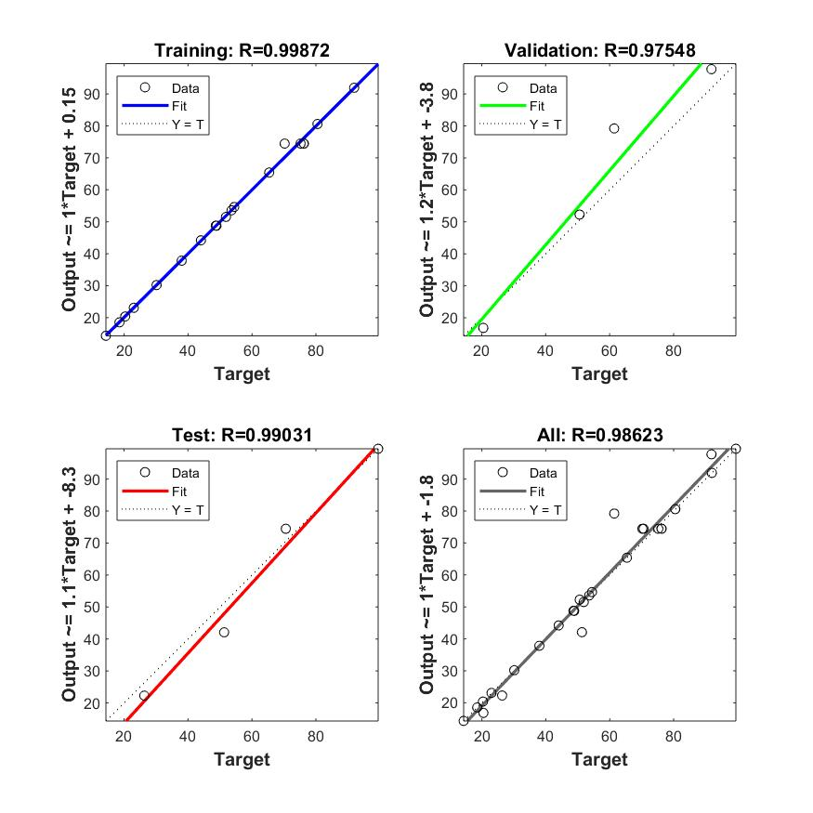
Figure depicting Values of R for different stages of training

Slide 17
Future Recommendations
ANN is to be used widely in nearly every field of modelling so using it in a precise manner would help us reach results economically and faster .
Using ANN would save a lot of time to check the degradation experimentally , because using it we can predict the results in a couple of seconds hence research should be promoted on using ANN in degradation techniques.
Research in degradation of air pollutants along with modelling using ANN would give a new way out for chemical industries involving SOx,NOx and other harmful species.

Slide 18
References
M.Zulfiqar, M.F.R.Samsudin, S.A.Taqvi, S.Sufian(2019), Modelling and optimization of photocatalytic degradation of phenol via TiO2 nanoparticles: An insight into response surface methodology and artificial neural network, vol. 400, p. 112-649.
M.Tanzifi, M.T.Yaraki, A.D.Kiadehi, S.H.Hosseini, M.Olazar, A.K. Bhati, S.Agarwal, V.K.Gupta, A.Kazemi(2018), Adsorption of Amido Black 10B from aqueous solution using polyaniline/SiO2 nanocomposite: Experimental investigation and artificial neural network modeling, vol. 510, p. 246-261.
M.Tanzifi, M.T.Yaraki, M.Karami, S.Karimi, A.D.Kiadehi, K.Karimipour, S.Wang(2018), Modelling of dye adsorption from aqueous solution on polyaniline/carboxymethyl cellulose/TiO2 nanocomposites, vol. 519 , p. 154-173.
I.Ali , O.M.L.Alharbi , Z.A.Alothmanc, A.Y. Badjah ,A. Alwarthan , A.A.Basheer(2018), Artificial neural network modelling of amido black dye sorption on iron composite nano material: Kinetics and thermodynamics studies, vol. 25, p. 1-8 .

Slide 19
C. A. Franco, T. Montoya,N. N. Nassar,P.P.Almao, F.B. Cortés(2013), Adsorption and Subsequent Oxidation of Colombian Asphaltenes onto Nickel and/or Palladium Oxide Supported on Fumed Silica Nanoparticles, vol. 80, p. 65-223.
R.Stiuﬁuc, C.Iacovita,C. M. Lucaciu, G. Stiuﬁuc, R. Nicoara, M. Oltean, V. Chis, E. Bodoki(2013), Adsorption geometry of propranolol enantiomers on silver nanoparticles, vol. 1031, p. 201-206.
A. saxena, H. Mangal, P.K.Rai, A.S.Rawat, V. Kumar, M.Dutta(2010), Adsorption of diethylclorophosphate on metal oxide nanoparticles under static condition, vol. 180, p. 566-576.
B. Pergolese, M. Muniz-Miranda, A.Bigotto(2004), Adsorption Models of Bipyrazine on Silver Colloidal Nanoparticles: a Computational Study, vol. 2, p. 000-008.
M.F.Samsudin, P.J.Jayabalan, W.J. Ong, Y.H.Ng, S.Sufian(2019), Photocatalytic degradation of real industrial poultry wastewater via platinum decorated BiVO4/g-C3N4 photocatalyst under Photobiol. A:Chem., vol. 378, p. 46–56.

Slide 20
THANK YOU

